Slide 1
Procedural Modeling of Complex Systems
Bernhard Rainer¹ and Silvester Farda¹
¹TU Wien, Austria
and Algorithms
Vienna University of Technology
² <insert 2nd affiliation (institute) here>
<insert 2nd affiliation (university) here>

Slide 2
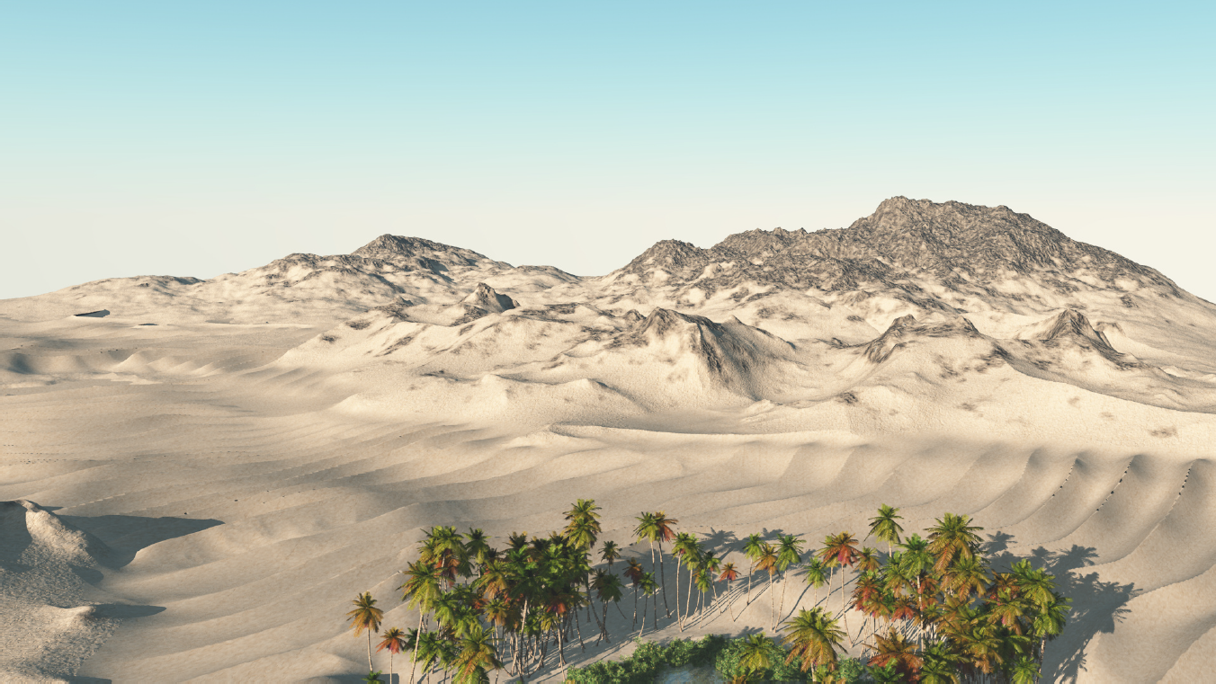
Motivation

Slide 3
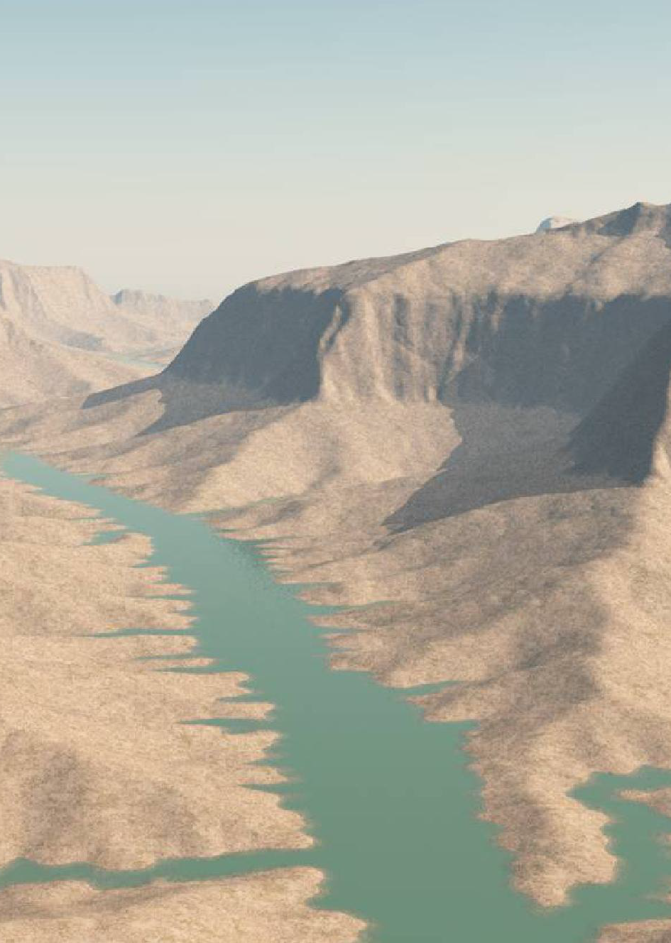
Motivation
Systems too complex to model by hand
Create physically plausible systems
Create realistic systems
Create good looking systems

Slide 4
Outline
Powerful data structure for terrain creation
River networks
Tectonic uplift
3D data structures
Erosion through fluids and sediment Transport
Particle based models
Heat transfer systems

Slide 5
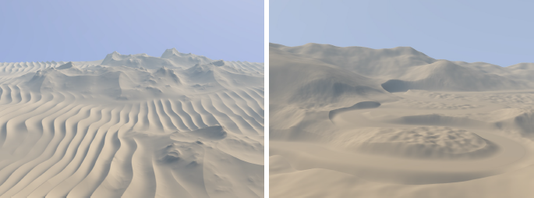
Terrain Modeling from Feature Primitives

Slide 6
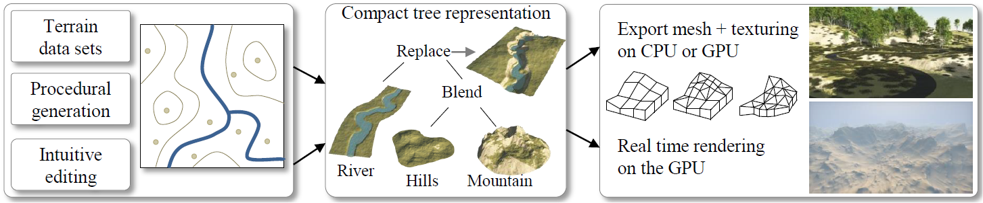
Terrain Modeling from Feature Primitives
Interprets terrain as combination of primitives
Uses a construction tree
Leave nodes are primitives
Inner nodes are operators

Slide 7
Terrain Modeling from Feature Primitives
Feature Primitives
Describe landmark features
Different primitive types:
Skeletal primitives
Contour primitives
Image primitives (e.g. heightmaps)
Have a weight function

Slide 8
Terrain Modeling from Feature Primitives
Skeletal Primitives
Disc primitive
radius, center, noise function
Used for peculiar mountains, etc.
Curve primitive
Curve skeleton, set of cross sections
Used for rivers, roads, etc.

Slide 9
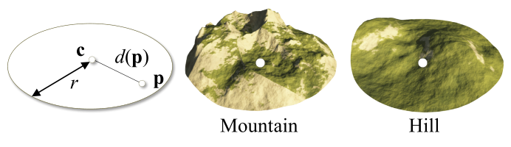
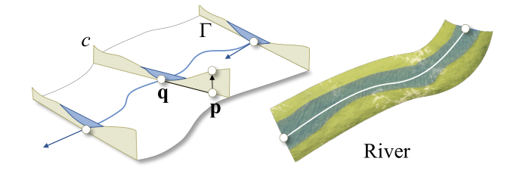
Terrain Modeling from Feature Primitives

Slide 10
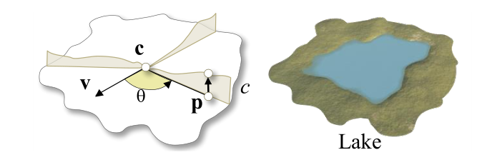
Terrain Modeling from Feature Primitives
Contour Primitives
Curve around center, set of profile curves describe the elevation in radial direction
Used for more complex features, like lakes

Slide 11
Terrain Modeling from Feature Primitives
Operators
Combine several primitives using their weight functions
Addition
Blend
Replace
Warp

Slide 12
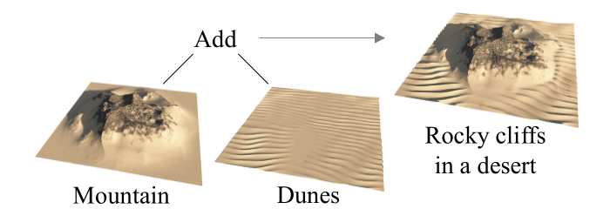
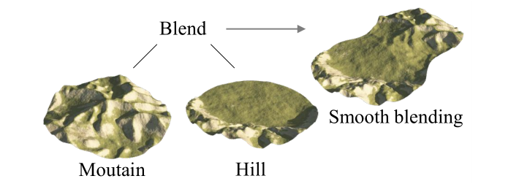
Terrain Modeling from Feature Primitives

Slide 13
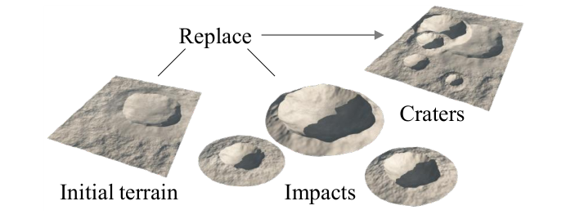
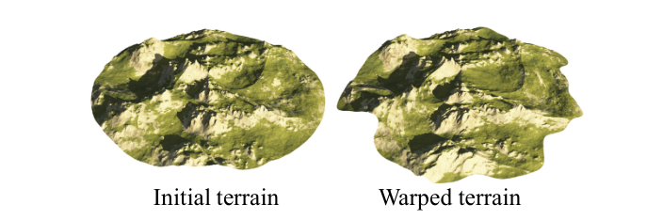
Terrain Modeling from Feature Primitives

Slide 14
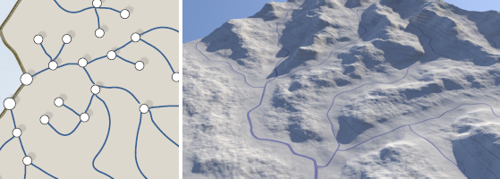
Terrain Generation Using Procedural Models Based on Hydrology
Create terrain from river network
Generate river network using probabilistic approach
Iteratively grow river network

Slide 15
Terrain Generation Using Procedural Models Based on Hydrology
River network can be interpreted as graph, whose nodes are:
Spring
Fork
Mouth
Each node has:
Position
Priority Index

Slide 16
Terrain Generation Using Procedural Models Based on Hydrology
River network generation
Node selection
Node expansion
Node creation
Repeat until all nodes are connected to river mouth

Slide 17
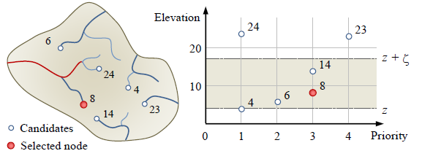
Terrain Generation Using Procedural Models Based on Hydrology
Node Selection
Candidate nodes are nodes that can be expanded from
Select node from candidate nodes based on heuristic that takes into account the elevation and priority index

Slide 18
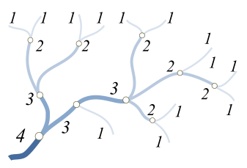
Terrain Generation Using Procedural Models Based on Hydrology
Node Expansion
Create new node
Type defined by:
Probabilities (supplied from user)
Horton-Strahler number
Node Creation
Insert created node
Check for correctness

Slide 19
Terrain Generation Using Procedural Models Based on Hydrology
Primitive Generation
Create Voronoi diagram of graph
For each Voronoi cell:
Create junctions between water inflows first, then connect to outflow(s)
Junction angle is influenced by waterflow
Use Horthon-Strahler number as waterflow
Predefined types of water-courses

Slide 20
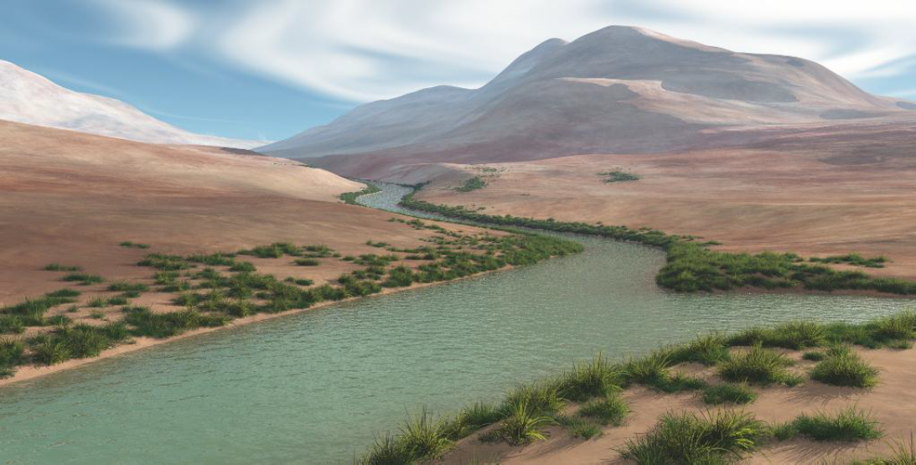
Terrain Generation Using Procedural Models Based on Hydrology
Compute heightfield with Poisson distribution, restricted by distance to watershed
Insert primitives into construction tree

Slide 21
Large Scale Terrain Generation from Tectonic Uplift and Fluvial Erosion
Terrain = result from combined action of tectonic uplift and erosion
Uplift map = speed at which terrain is elevated by tectonics
Fluvial erosion = erosion of bedrock material and its transportation downhill
Stream Power equation = rate of change of surface topography, controlled by uplift and erosion

Slide 22
Large Scale Terrain Generation from Tectonic Uplift and Fluvial Erosion
Algorithm
Create randomly triangulated graph
Extract set of stream trees according to current elevation
Add new arcs to stream tree from overflowing lakes
Compute drainage area and local slope
Solve stream power equation
Stop when stabilization criterion is met

Slide 23
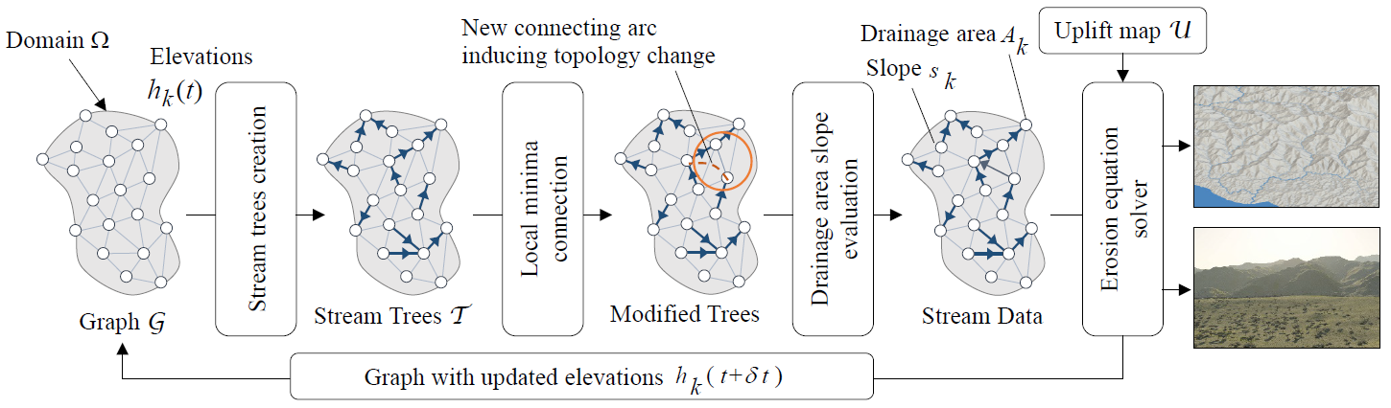
Large Scale Terrain Generation from Tectonic Uplift and Fluvial Erosion

Slide 24
Large Scale Terrain Generation from Tectonic Uplift and Fluvial Erosion
Repeat for multiple time steps, with modified graph as input
Use proper time steps and scales.
Terrain size: 50x50 km
Max. tectonic uplift = 5.0 * 10⁻⁴ meters per year
Simulation time step: 2.5 * 10⁵ years
Create Feature primitives from final graph

Slide 25
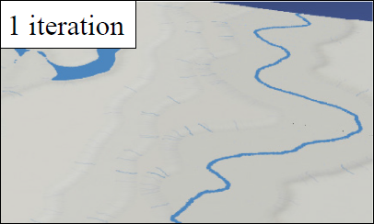
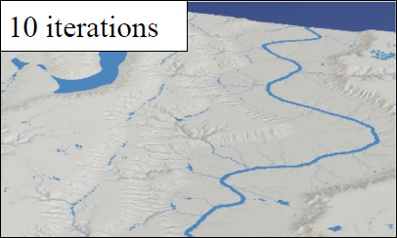
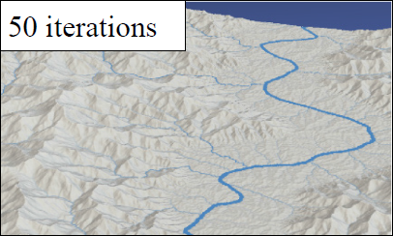
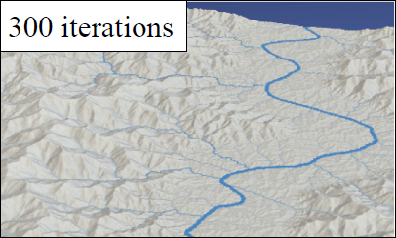
Large Scale Terrain Generation from Tectonic Uplift and Fluvial Erosion

Slide 26
Layered Data Representation simulating Terrain Erosion
How to store 3D data efficiently?
Detailed voxel grid
High memory usage
Slow calculation
Very exact
Hightmap
Fast calculation
Low memory usage
Not physically correct results

Slide 27
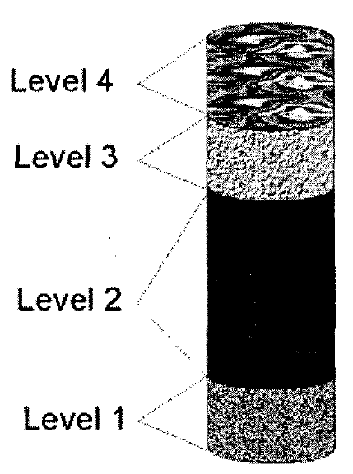
Layered Data Representation simulating Terrain Erosion
Solution: Layerd data structute
Hybrid approach
2D Grid
Several layers stacked on top each other
Each material has constant attributes for the whole level

Slide 28
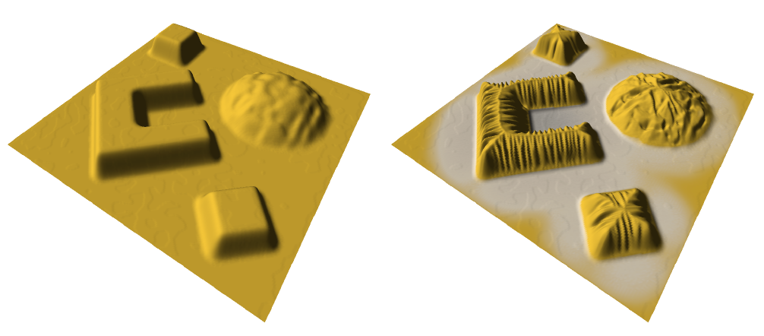
Erosion-based terrain generation & modification
Erosion deforms terrain over time
Letting terrain be erroded produced realistic results
Visually and physically plausible surfaces are created

Slide 29
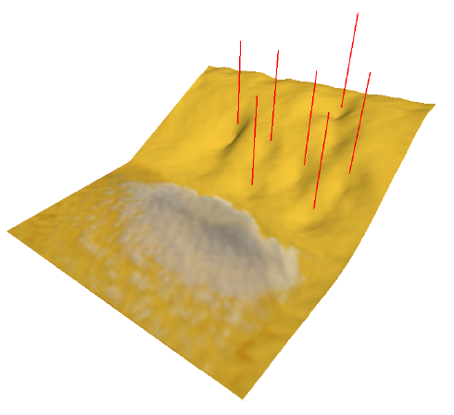
Interactive physically-based Fluid and Erosion Simulation
Fluids have big influences on overall look of tarrain
Water transports and adds / removes sediment from the scene

Slide 30
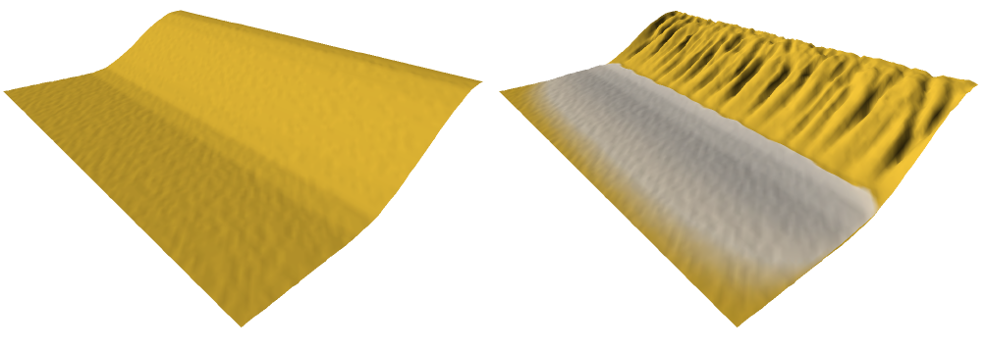
Interactive physically-based Fluid and Erosion Simulation
Calculations are done by using simplified Navier-Stokes equations
Some 3D information has to be discarded for speed
Primary focus: movement of sediment

Slide 31
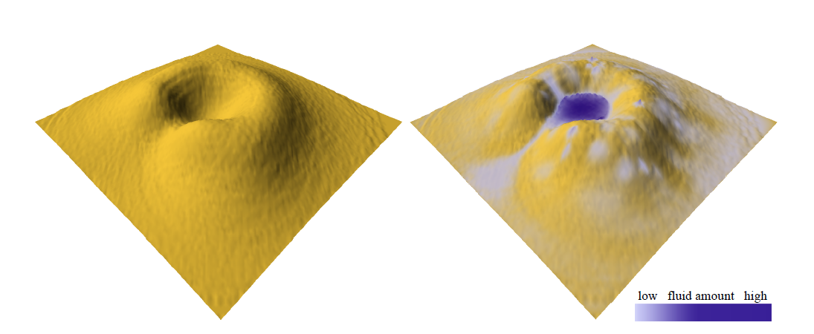
Interactive physically-based Fluid and Erosion Simulation
All materials have specific attributes:
Sediment capacity
Deposition rate
Dissolving rate

Slide 32
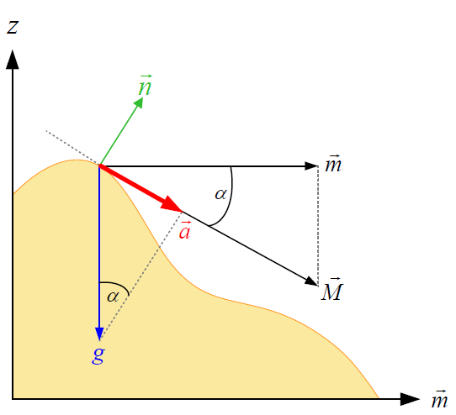
Interactive physically-based Fluid and Erosion Simulation
Calculation requires:
Fluid attributes (last slide)
Allready dissolved sediment in the fluid
Surface gradient
Fluid velocity
Fluid accelleration

Slide 33
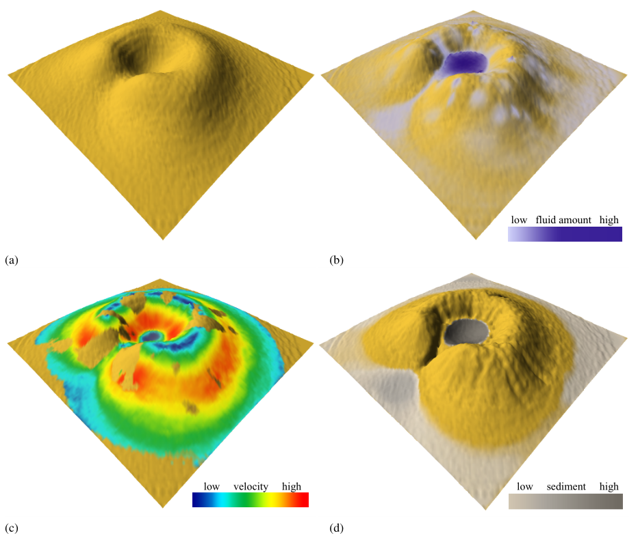
Interactive physically-based Fluid and Erosion Simulation

Slide 34
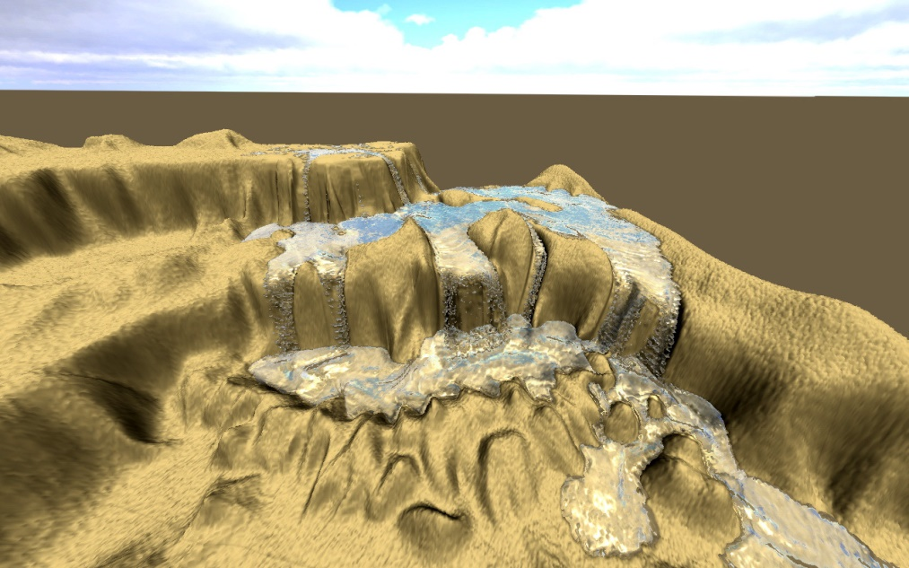
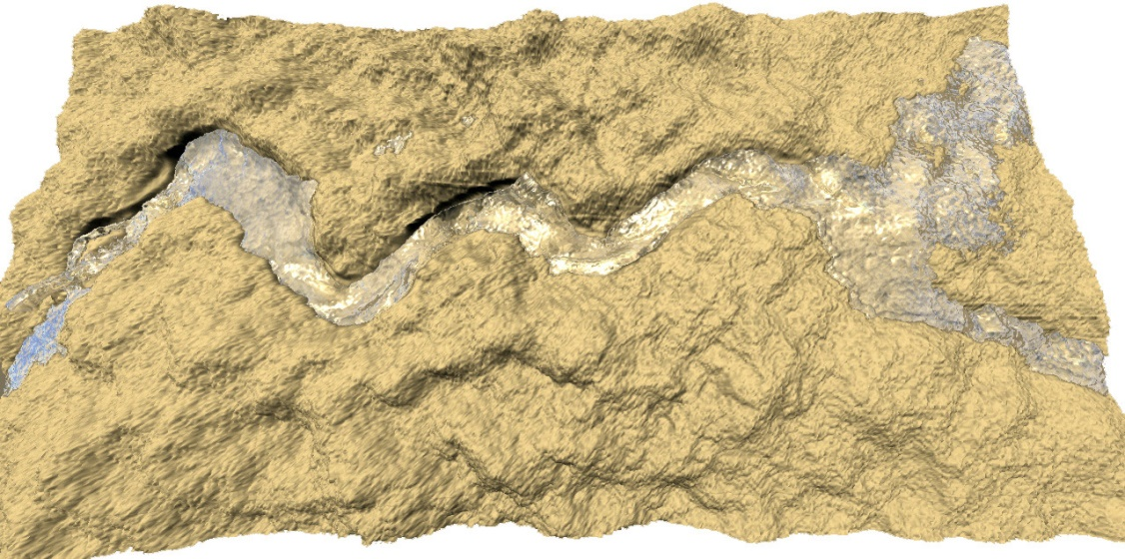
Hydraulic Erosion Using Smooth-Particle Hydrodynamics
Particle-based erostion system

Slide 35
Hydraulic Erosion Using Smooth-Particle Hydrodynamics
Two different approaches:
Eulerian method
Focus on hydraulic erosion
Hybrid-approaches for real-time compatibility
Lagrangian method
Based on Somth Particle Hydrodynamics (SPH)
Also often used with hybrid approaches

Slide 36
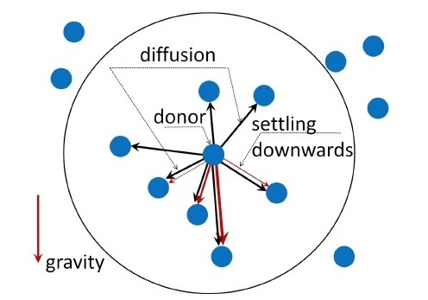
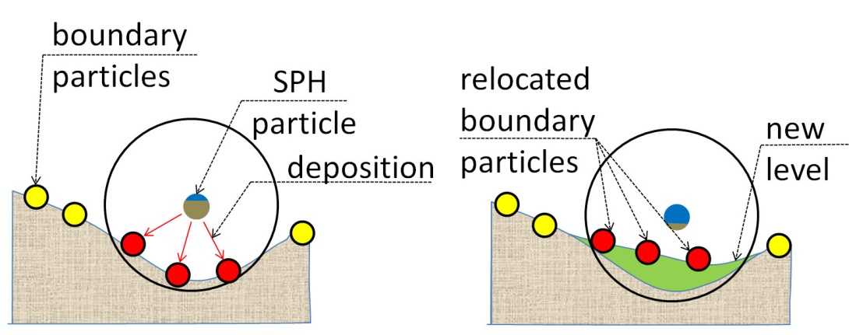
Hydraulic Erosion Using Smooth-Particle Hydrodynamics
Lagrangian method (continued)
Donor-Acceptor Scheme:
Boundary particles:

Slide 37
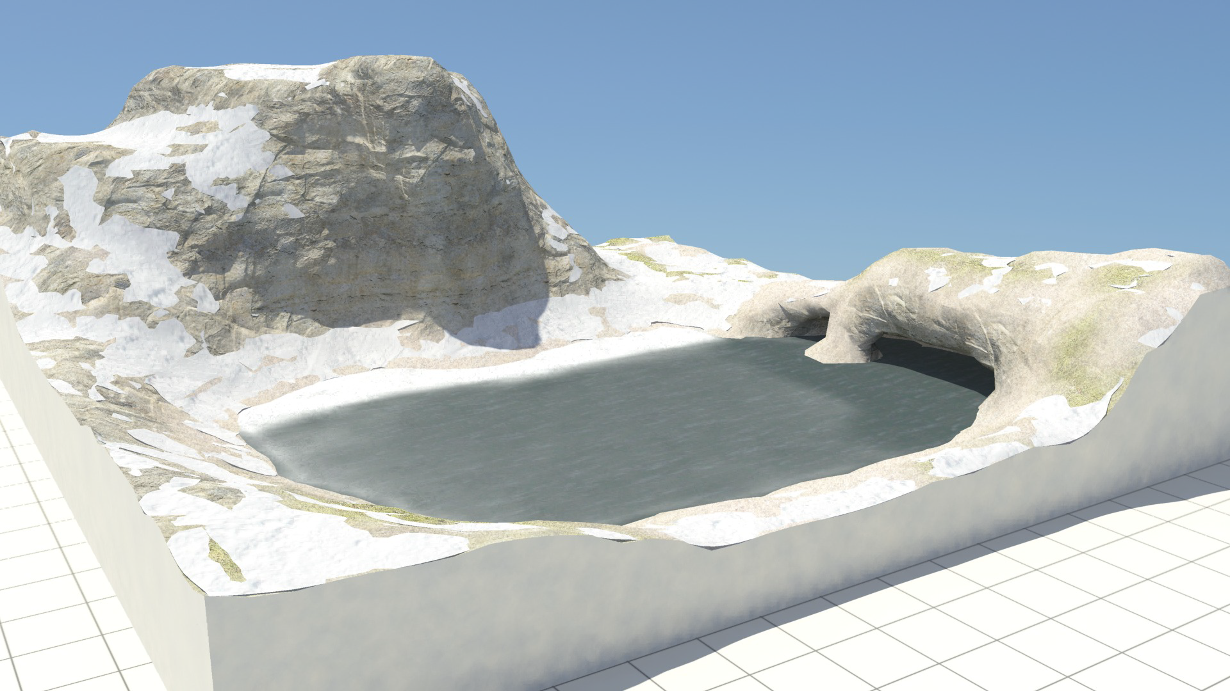
Heat Transfer Simulation in Winter Scenarios

Slide 38
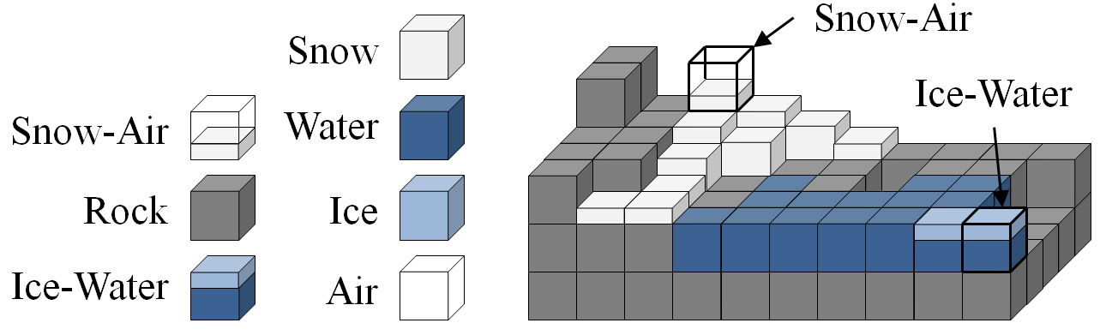
Heat Transfer Simulation in Winter Scenarios
Complex simulation involving a lot of physics
Not only surface effects have to be concidered

Slide 39
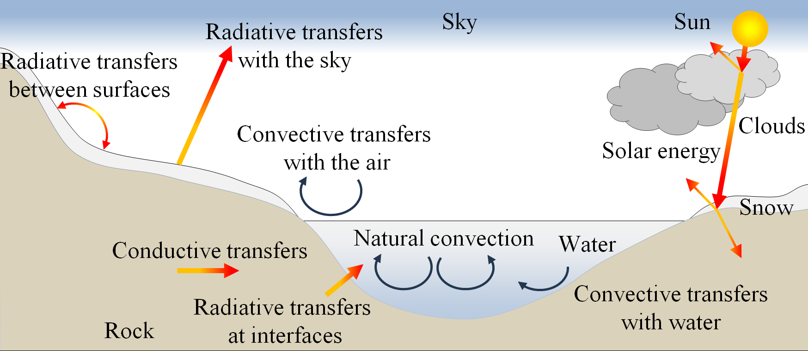
Heat Transfer Simulation in Winter Scenarios
A variety of phsical phenomena has to be taken into account

Slide 40
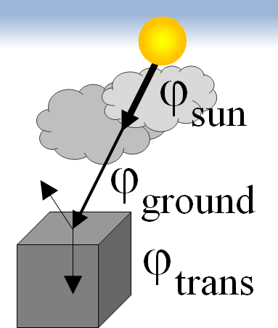
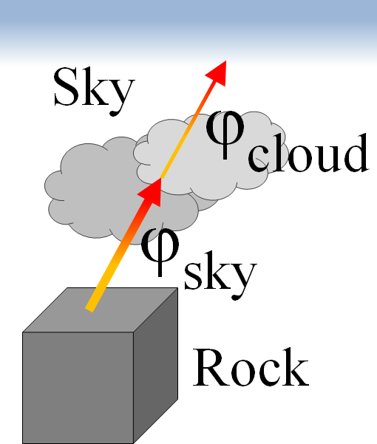
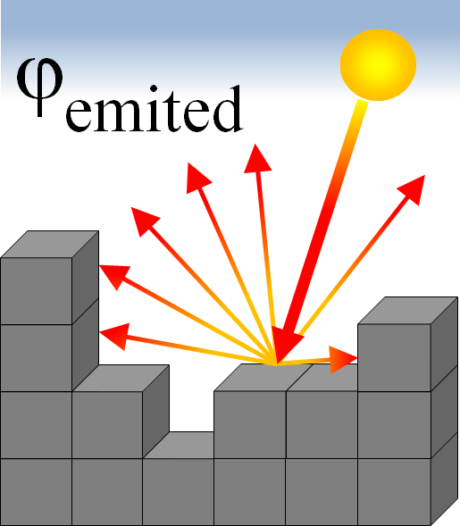
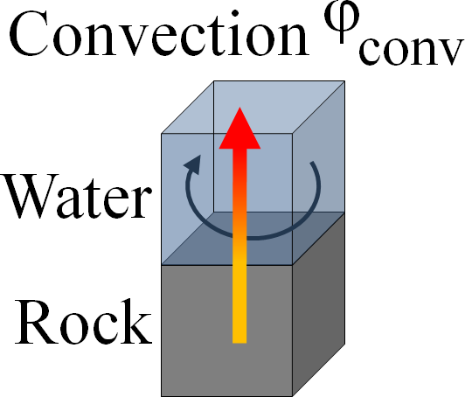
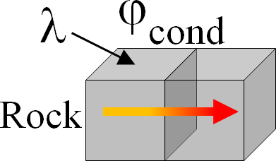
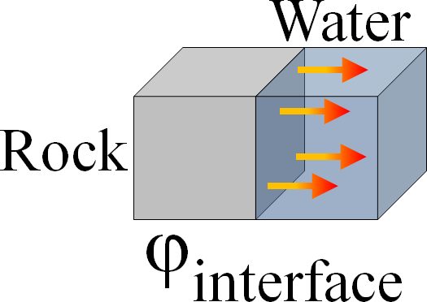
Heat Transfer Simulation in Winter Scenarios
Radiation, reflection, convection, …

Slide 41
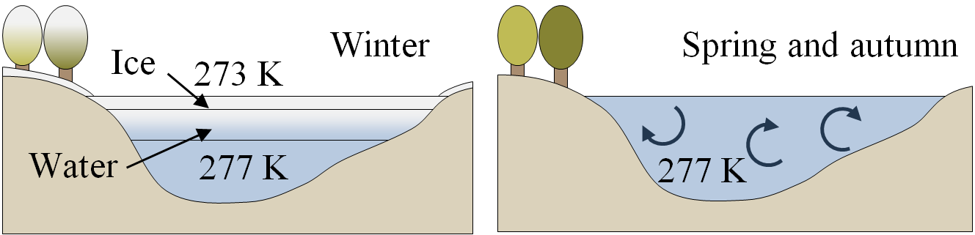
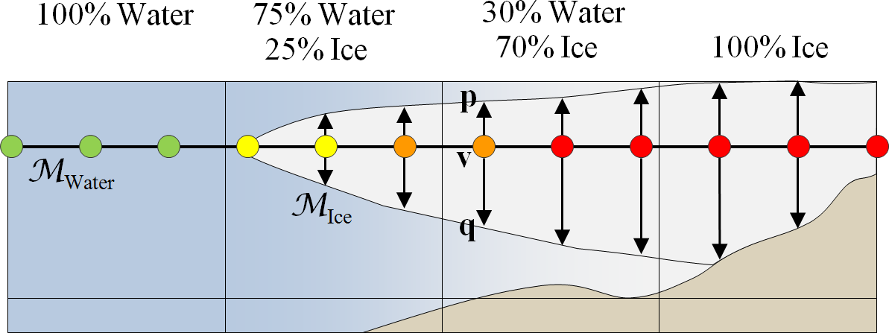
Heat Transfer Simulation in Winter Scenarios
Convection, temperature layers and freezing water

Slide 42
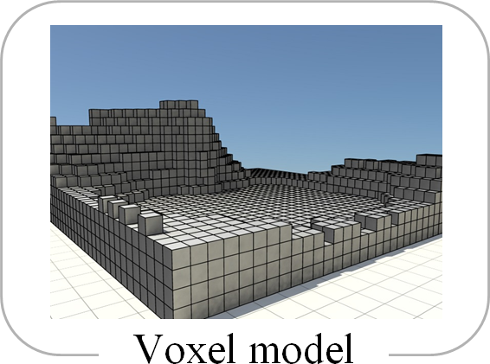
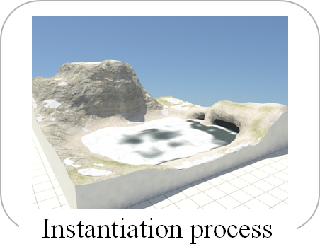
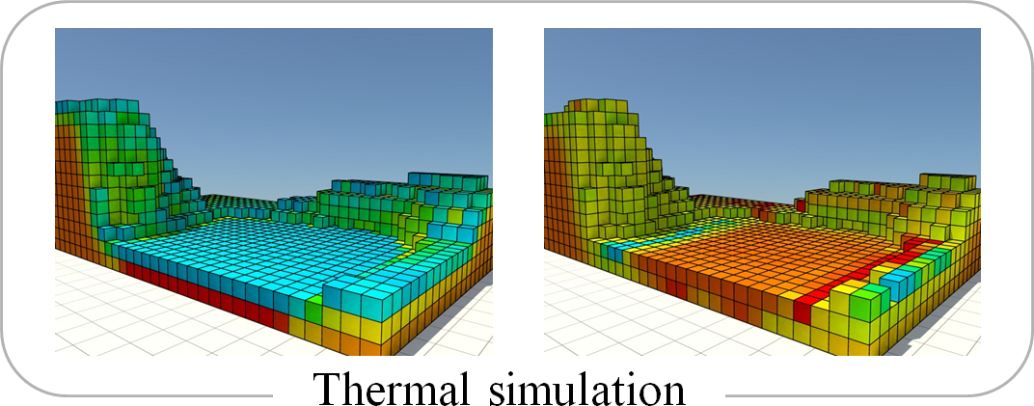
Heat Transfer Simulation in Winter Scenarios
The Pipeline

Slide 43
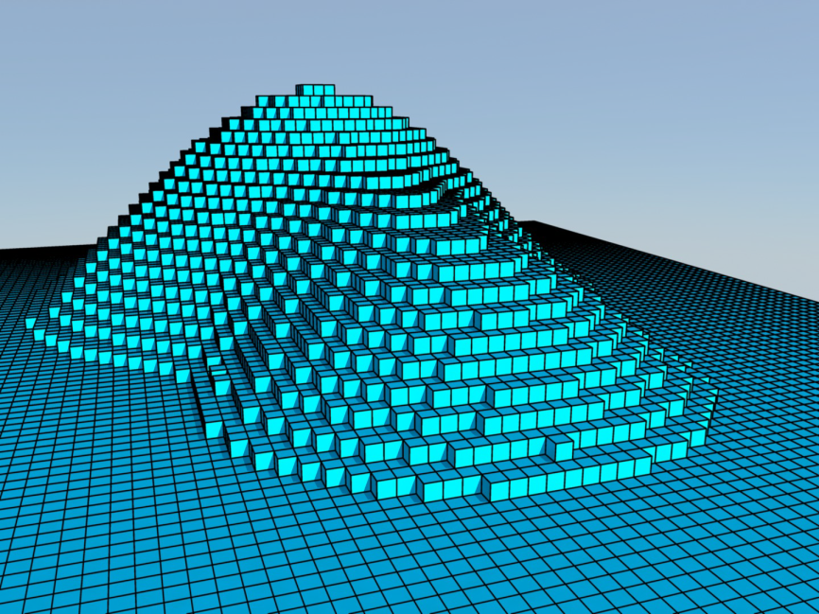
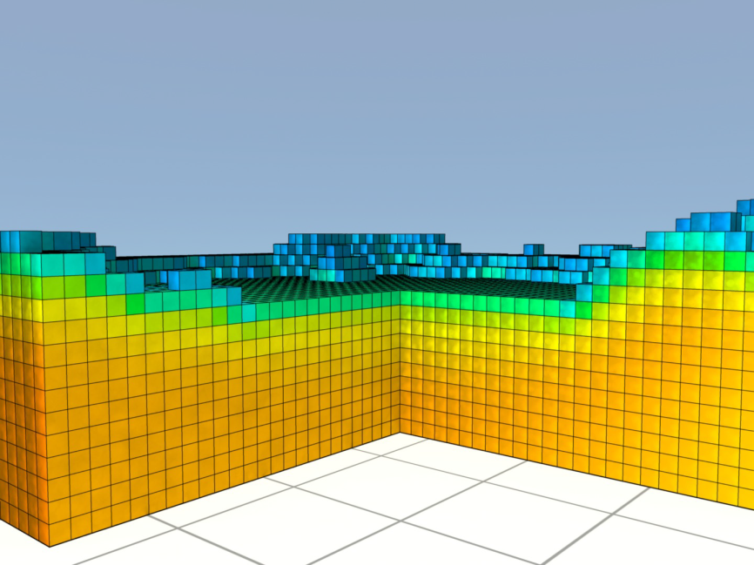
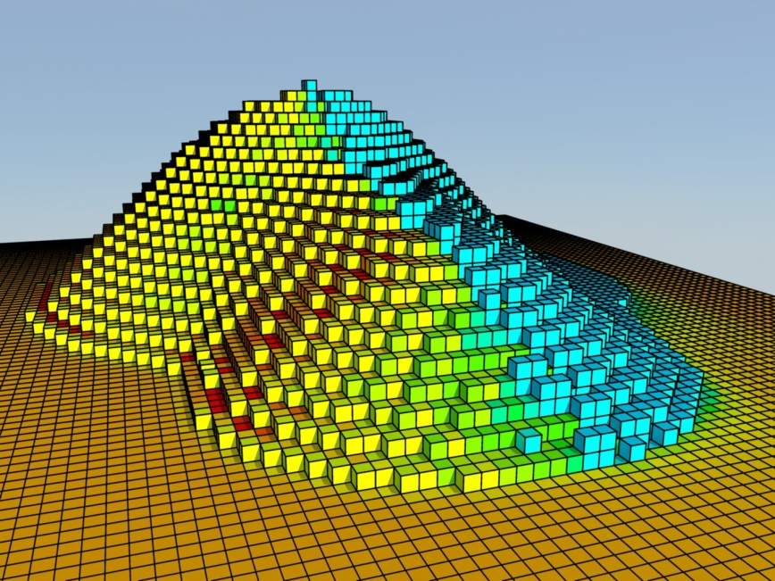
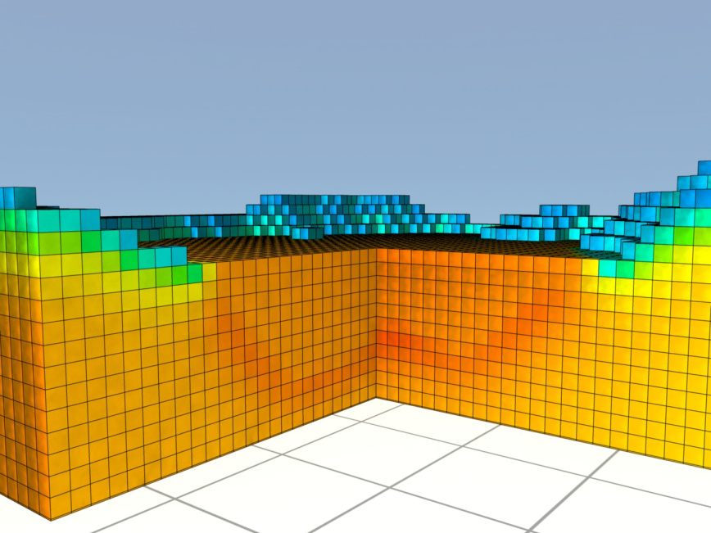
Heat Transfer Simulation in Winter Scenarios

Slide 44
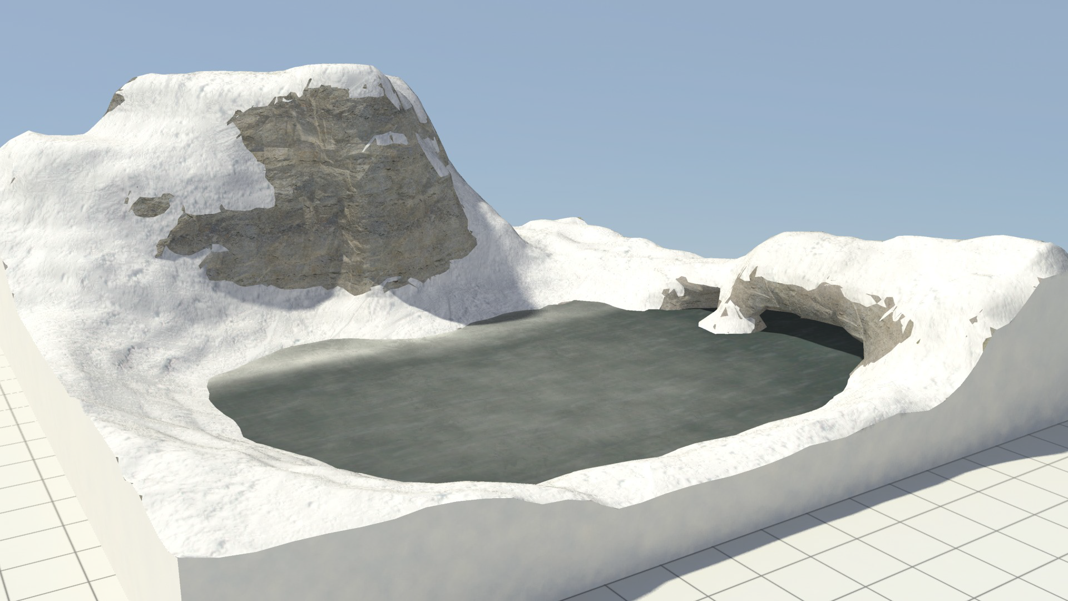
Heat Transfer Simulation in Winter Scenarios

Slide 45

Heat Transfer Simulation in Winter Scenarios

Slide 46

Heat Transfer Simulation in Winter Scenarios

Slide 47

Heat Transfer Simulation in Winter Scenarios

Slide 48
The End
Questions?

Slide 49
Sources & References
[BF01] BENES B., FORSBACH R.: Layered data representation for visual simulation of terrain erosion. In Computer Graphics, Spring Conference on, 2001. (2001), IEEE, pp. 80–86. 10
[CBC∗16] CORDONNIER G., BRAUN J., CANI M.-P., BENES B., GALIN E., PEYTAVIE A., GUÉRIN E.: Large scale terrain generation from tectonic uplift and ﬂuvial erosion. In Computer Graphics Forum (2016), vol. 35, Wiley Online Library, pp. 165–175. 9
[GGG∗13] GÉNEVAUX J.-D., GALIN E., GUÉRIN E., PEYTAVIE A., BENES B.: Terrain generation using procedural models based on hydrology. ACM Trans. Graph. 32, 4 (July 2013), 143:1– 143:13. URL: http://doi.acm.org/10.1145/2461912. 2461996, doi:10.1145/2461912.2461996. 1, 5
[GGP∗15] GÃL’NEVAUX J.-D., GALIN E., PEYTAVIE A., GUÃL’RIN E., BRIQUET C., GROSBELLET F., BENES B.: Terrain modelling from feature primitives. Computer Graphics Forum 34, 6 (2015), 198– 210. URL: http://dx.doi.org/10.1111/cgf.12530, doi: 10.1111/cgf.12530. 1, 2
[KBKŠ09] KRIŠTOF P., BENEŠ B., KˇRIVÁNEK J., ŠT’AVA O.: Hydraulic erosion using smoothed particle hydrodynamics. In Computer Graphics Forum (2009), vol. 28, Wiley Online Library, pp. 219–228. 8, 9
[MGG∗10] MARÉCHAL N., GUÉRIN E., GALIN E., MÉRILLOU S., MÉRILLOU N.: Heat transfer simulation for modeling realistic winter sceneries. In Computer Graphics Forum (2010), vol. 29, Wiley Online Library, pp. 449–458. 9
[NWD05] NEIDHOLD B., WACKER M., DEUSSEN O.: Interactive physically based ﬂuid and erosion simulation. In Proceedings of the First Eurographics Conference on Natural Phenomena (Aire-la-Ville, Switzerland,Switzerland,2005),NPH’05,EurographicsAssociation,pp.25–33. URL: http://dx.doi.org/10.2312/NPH/NPH05/025-032, doi:10.2312/NPH/NPH05/025-032. 3
[RSKN08] RUNGJIRATANANON W., SZEGO Z., KANAMORI Y., NISHITA T.: Real-time animation of sand-water interaction. In Computer Graphics Forum (2008), vol. 27, Wiley Online Library, pp. 1887– 1893. 7

